Slide 1
Parent Power School
July 30, 2016

Slide 2
What is Advocacy?
Activity by an individual or group which aims to influence decisions within political, economic and social institutions
Advocacy is a process of:
Expressing your views and concerns
Accessing information
Defending and promoting your rights and views

Slide 4
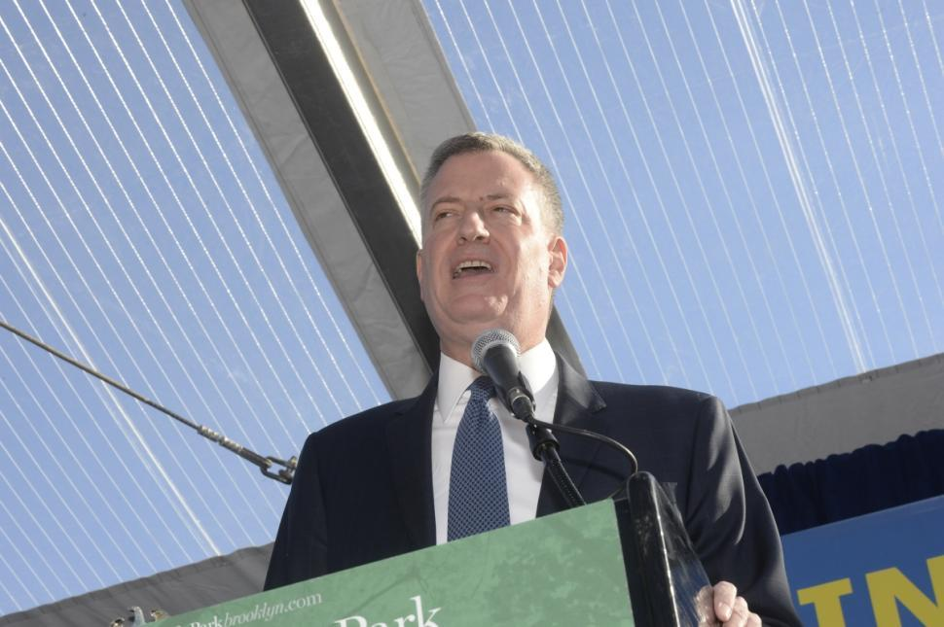
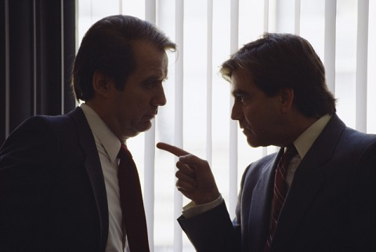
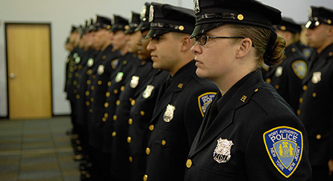
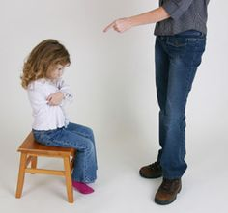
Authority
The ability to give orders, make decisions, and enforce obedience
Notes:
Should I put pictures of authority figures?

Slide 5
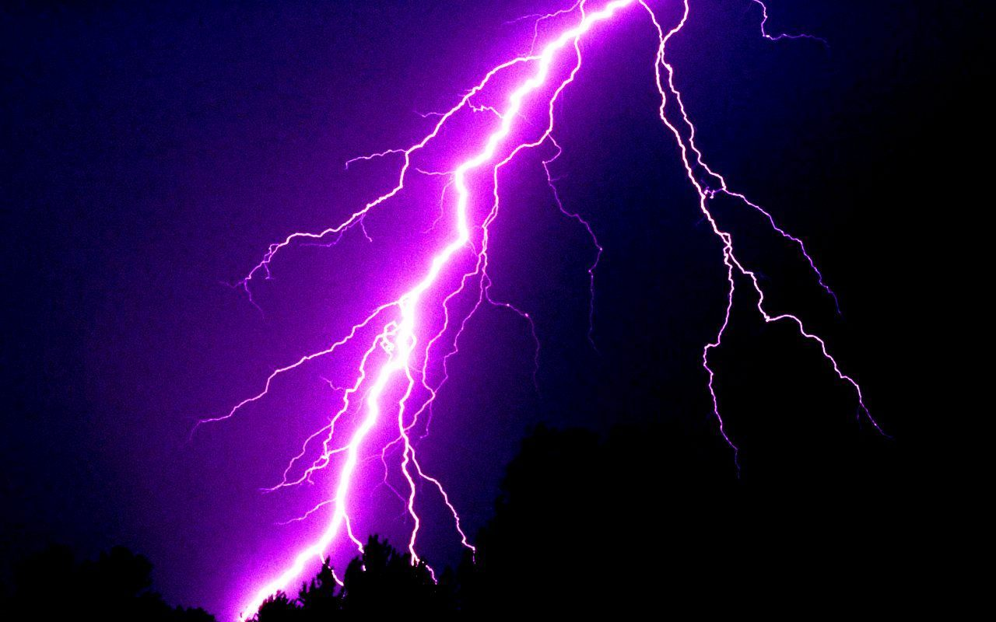
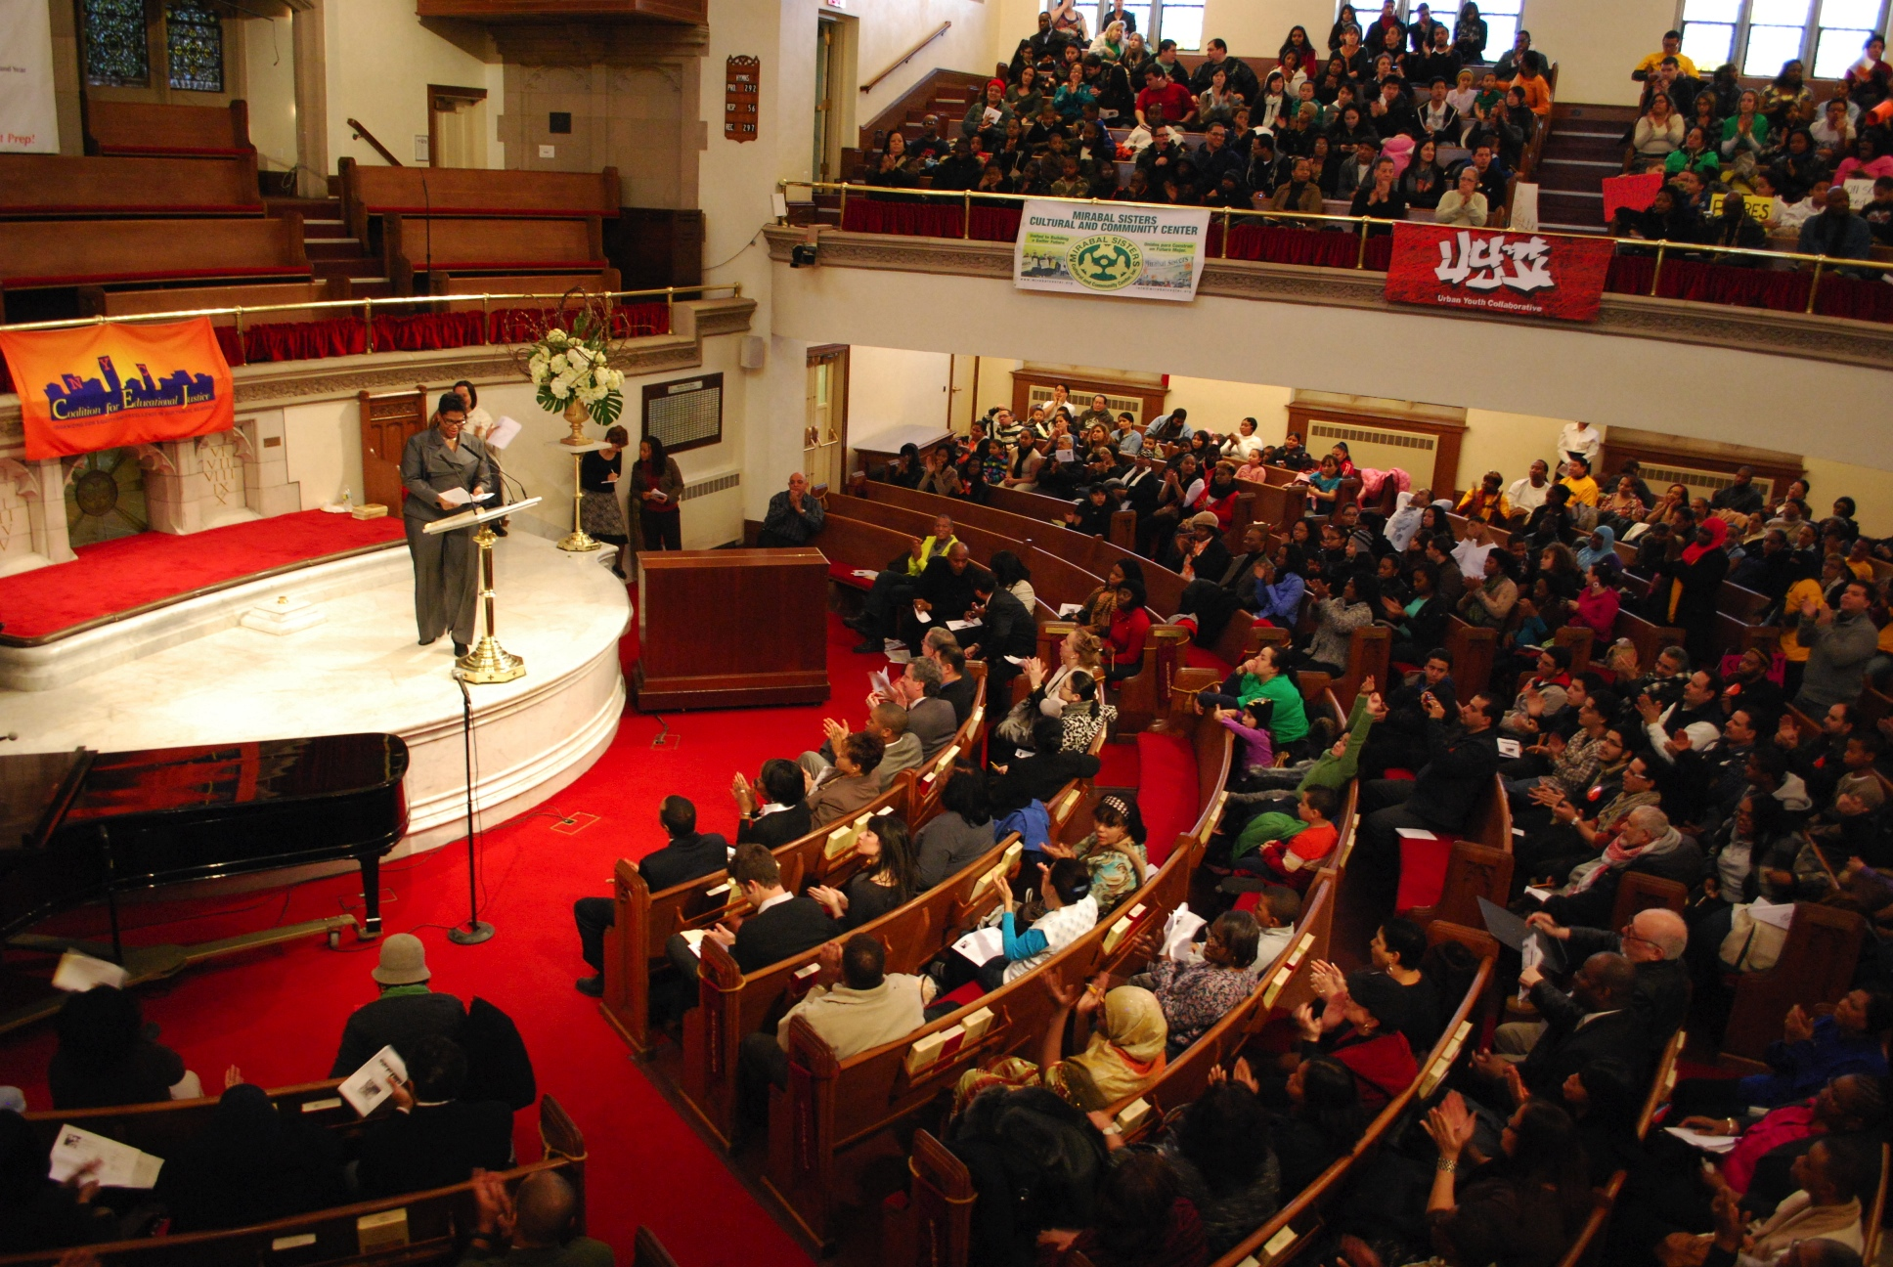
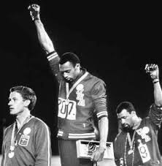
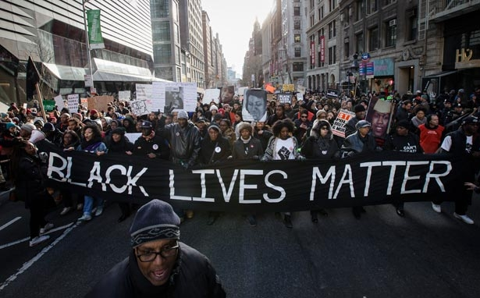
Power
Ability to direct or influence the behavior of others, those in authority or the course of events.
Notes:
Should

Slide 6
Authority vs. Power
Power is innate. It does not require consent and is not given, therefore cannot be taken away
Authority must be given, through elections or appointment, etc. and thus can be taken away
Weber: power is tied to the personal characteristics of individuals or groups, whereas authority is always tied to social positions or roles

Slide 7
Personal Power Styles
Mouse: Some of us avoid our power
Talk too little: Clam up and lose your voice
Feel like everyone else knows more than you
Under-planner, lose track of the goal and the focus
Get nervous and defensive
Just want everyone to get along

Slide 8
Bull: Some of us push into our power
Talk too much: Mouth off but not on topic
Feel like you know more than everyone
Over-planner, over-think it
Get angry and aggressive
Doesn’t care what anyone thinks

Slide 9
Eagle: Use power in a balanced way
Knows when to talk and when to step back
Plan strategically
Keep emotions in control when necessary
Listens and observes before speaking
Is self-aware

Slide 10
Discussion
What characteristics to you see in yourself, when you’re faced with authority figures?
Which mix of types are you?
What experiences led to you being that type?

Slide 11
Assata Shakur
It is our Duty to Fight for our Freedom
It is our Duty to Win
We must Love and Protect one another
We have Nothing to lose but our Chains

